Slide 1
NOSQL
Yan Cui
@theburningmonk

Slide 2







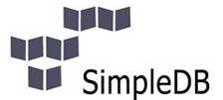




Server-side Developer @

Slide 3
iwi by numbers
400k+ DAU
~100m requests/day
25k+ concurrent users
1500+ requests/s
7000+ cache opts/s
100+ commodity servers (EC2 small instance)
75ms average latency

Slide 4
Sign Posts
Why NOSQL?
Types of NOSQL DBs
NOSQL In Practice
Q&A

Slide 5
Current Trends
A look at the…

Slide 6
Notes:
5 exabytes of data from the dawn of civilization to 2003. Now we generate that much data every 2 days.

Slide 7
Big Data
“…data sets whose size is beyond the ability of commonly used software tools to capture, manage and process within a tolerable elapsed time…”
Notes:
The challenge facing many developers operating within the web/social space is how to cope with ever increasing volumes of data, and that challenge is commonly referred to as ‘Big Data’. Given that the size of the digital universe is predicated to continue to grow exponentially for the foreseeable future, life is not gonna get easier for us developers anytime soon!

Slide 8
Big Data
Unit | Symbol | Bytes
Kilobyte | KB | 1024
Megabyte | MB | 1048576
Gigabyte | GB | 1073741824
Terabyte | TB | 1099511627776
Petabyte | PB | 1125899906842624
Exabyte | EB | 1152921504606846976
Zettabyte | ZB | 1180591620717411303424
Yottabyte | YB | 1208925819614629174706176
PAIN-O-Meter
Notes:
Just how big does your data have to be for it to be considered a ‘Big Data’? Understandably, it is a moving target, but generally speaking, when you cross over the terabyte threshold you’re starting to step into the ‘Big Data’ zone of pain.

Slide 9

Notes:
So how exactly do we tame the beast that is ‘Big Data’?

Slide 10
Vertical Scaling
Server | Cost
PowerEdge T110 II (basic) 8 GB, 3.1 Ghz Quad 4T | $1,350
PowerEdge T110 II (basic) 32 GB, 3.4 Ghz Quad 8T | $12,103
PowerEdge C2100 192 GB, 2 x 3 Ghz | $19,960
IBM System x3850 X5 2048 GB, 8 x 2.4 Ghz | $646,605
Blue Gene/P 14 teraflops, 4096 CPUs | $1,300,000
K Computer (fastest super computer) 10 petaflops, 705,024 cores, 1,377 TB | $10,000,000 annual operating cost
Notes:
The traditional wisdom says that we should get bigger servers! And sure, it’ll work, to some extent, but it’ll cost you! In fact, the further up the food chain you go, the less value you get for your money as the cost of the hardware goes up exponentially.

Slide 11
Horizontal Scaling
Incremental scaling
Cost grows incrementally
Easy to scale down
Linear gains

Slide 12
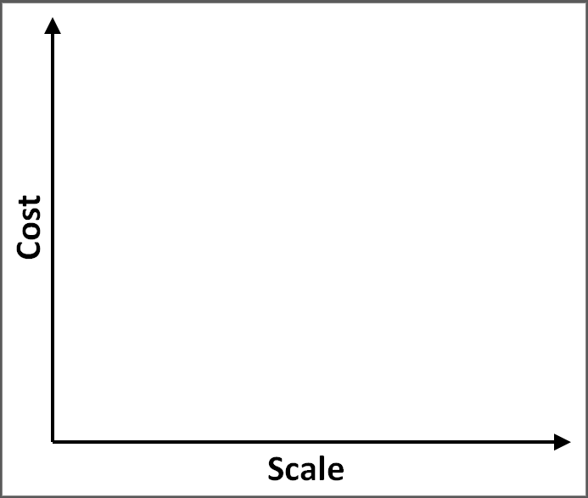
Notes:
If you consider scaling purely as a function of cost, then if you can keep your cost under control and make sure that it increases proportionally to the increases in scale then it’s happy days all around! You’re happy, your boss is happy, marketing’s happy, and the shareholders are happy.
On the other hand, if you choose to fight big data with big hardware, then your cost to scale ratio is likely to clime significantly, leaving you out of pocket. And when everyone decides to play that game, it’ll undoubtedly make some people very happy...

Slide 13

Hardware Vendor
Notes:
...but unless you’re in the business of selling expensive hardware to developers you’re probably not the one laughing...
And since most of that hardware investment is made up-front, as a company, possibly a start up, you’ll be taking on a significant risk and god forbid if things don’t pan out for you...

Slide 14


Slide 15
Introducing NoSql
Here’s an alternative…

Slide 16
NOSQL is …
No SQL
Not Only SQL
A movement away from relational model
Consisted of 4 main types of DBs

Slide 17
NOSQL is …
Hard
A new dimension of trade-offs
CAP theorem
Notes:
In 2000, Eric Brewer gave a keynote speech at the ACM Symposium on the Principles of Distributed Computing, in which he said that as applications become more web-based we should stop worrying about data consistency, because if we want high availability in these new distributed applications, then guaranteed consistency of data is something we cannot have.
There are three core systemic requirements that exists in a special relationship when it comes to designing and deploying applications in a distributed environment – Consistency, Availability and Partition Tolerance.

Slide 18
CAP Theorem
A
Availability:
Each client can always read and write data
Consistency:
All clients have the same view of data
Partition Tolerant:
System works despite network partitions
C
P
Notes:
A service that is Consistent operates fully or not at all. (Consistent here differs from the C in ACID which describes a property of database transactions that ensure data will never be persisted that breaks certain pre-set constraints) This usually translates to the idea that multiple values for the same piece of data are not allowed.
Availability means just that – a service is available. Funny thing about availability is that it most often deserts you when you need it the most – during busy periods. A service that’s available but not accessible is no benefit to anyone.
A service that is Partition Tolerant can survive network partitions.
The CAP theorem says that you can only have two of the three.

Slide 19
NOSQL DBs are …
Specialized for particular use cases
Non-relational
Semi-structured
Horizontally scalable (usually)

Slide 20
Motivations
Horizontal Scalability
Low Latency
Cost
Minimize Downtime

Slide 21

Motivations
Use the right tool for the right job!

Slide 22
Vertical Scaling
The Good
The Bad
Simple to set up
Familiar to developers
Cost grows exponentially
Up-front hardware cost*
Difficult to scale down*
* : mitigated using Cloud services to some extent

Slide 23
Horizontal Scaling
The Good
The Bad
Incremental scaling
Cost grows incrementally
Easy to scale down
Linear gains
More complex programming model
More complex to manage

Slide 24
RDBMS
CAN scale horizontally (via sharding)
Manual client side hashing
Cross-server queries are difficult
Loses ACIDcity
Schema update = PAIN
Notes:
Before we move onto NoSQL databases, I just want to make it clear that IT IS POSSIBLE to scale horizontally with traditional RDBMS. However, there’s a number of drawbacks:
you have to implement client-side hashing yourself, which is not that hard and even some of the NoSQL DBs don’t provide clustering out of the box and requires manual implementation for client side hashing
once you’ve sharded your db, it means queries against a particular table now needs to be made across all the sharded nodes, making the orchestration and collection of results more complex
also, cross-node transactions is almost a no-go, and it’s difficult to enforce consistency and isolation in a distributed environment too, some specialized NoSQL DBs are designed to solve that problem but to force a similar solution onto a general purposed RDBMS is a recipe for disaster
schema updates on a large db is painful, schema update on a massive multi-node db cluster is a pain worse than death...

Slide 25
Types of nosql dbs

Slide 26
Types Of NOSQL DBs
Key-Value Store
Document Store
Column Database
Graph Database

Slide 27
Key-Value Store
“key”
“value”
101110100110101001100110100100100010101011101010101010110000101000110011111010110000101000111110001100000
morpheus

Slide 28
Key-Value Store
It’s a Hash
Basic get/put/delete ops
Crazy fast!
Easy to scale horizontally
Membase, Redis, ORACLE…

Slide 29
Document Store
“key”
“document”
{
name : “Morpheus”,
rank : “Captain”,
occupation: “Total badass”
}
morpheus

Slide 30
Document Store
Document = self-contained piece of data
Semi-structured data
Querying
MongoDB, RavenDB…

Slide 31
Column Database
Name
Last Name
Age
Rank
Occupation
Version
Language
Thomas Anderson
29
Morpheus
Captain
Total badass
Cypher
Reagan
Agent Smith
1.0b
C++
The Architect

Slide 32
Column Database
Data stored by column
Semi-structured data
Cassandra, HBase, …

Slide 33
Graph Database
name = “Morpheus”
rank = “Captain”
occupation = “Total badass”
name = “Thomas Anderson”
age = 29
name = “Cypher”
last name = “Reagan”
name = “The Architect”
KNOWS
7
KNOWS
3
1
9
disclosure = public
KNOWS
KNOWS
KNOWS
disclosure = secret
age = 6 months
age = 3 days
CODED_BY
2
5
name = “Trinity”
name = “Agent Smith”
version = 1.0b
language = C++

Slide 34
Graph Database
Nodes, properties, edges
Based on graph theory
Node adjacency instead of indices
Neo4j, VertexDB, …

Slide 35
NoSql In Practice
Real-world use cases for NoSQL DBs...

Slide 36
Redis
Remote dictionary server
Key-Value store
In-memory, persistent
Data structures

Slide 37
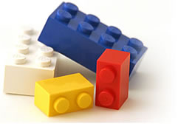
Redis
Sorted Sets
Lists
Sets
Hashes

Slide 38
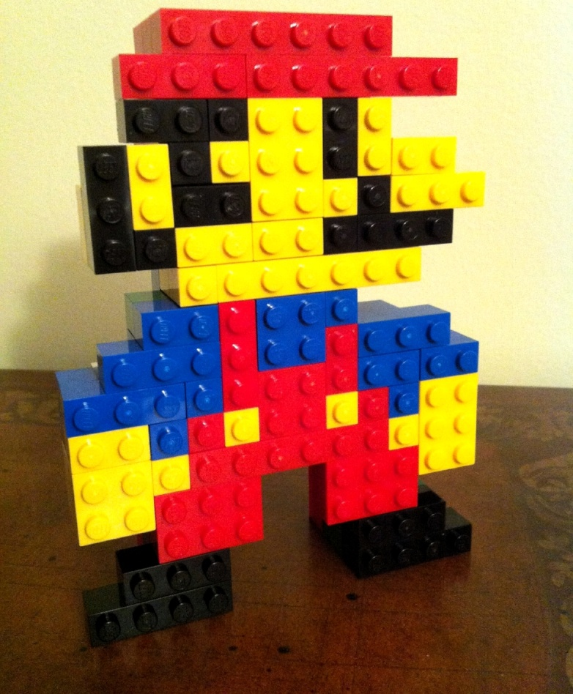
Redis

Slide 39
Counters
Redis in Practice #1

Slide 40

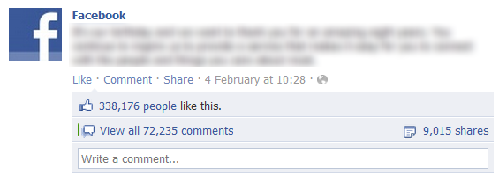
Counters
Potentially massive numbers of ops
Valuable data, but not mission critical

Slide 41
Counters
Lots of row contention in SQL
Requires lots of transactions

Slide 42
Counters
Redis has atomic incr/decr
INCR | Increments value by 1
INCRBY | Increments value by given amount
DECR | Decrements value by 1
DECRBY | Decrements value by given amount

Slide 43
Counters

Slide 44
Random items
Redis in Practice #2

Slide 45
Random Items
Give user a random article
SQL implementation
  select count(*) from TABLE
  var n = random.Next(0, (count – 1))
  select * from TABLE where primary_key = n
  inefficient, complex

Slide 46
Random Items
Redis has built-in randomize operation
SRANDMEMBER | Gets a random member from a set

Slide 47
Random Items
About sets:
  0 to N unique elements
  Unordered
  Atomic add

Slide 48
Random Items

Slide 49
Presence
Redis in Practice #3

Slide 50
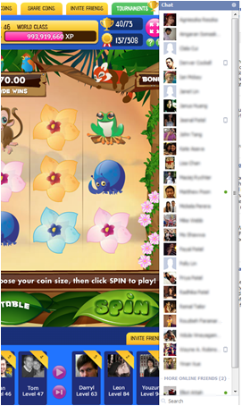
Presence
Who’s online?
Needs to be scalable
Pseudo-real time

Slide 51
Presence
Each user ‘checks-in’ once every 3 mins
00:22am
00:23am
00:24am
00:25am
00:26am
A
B
C
D
E
A
?
A, C, D & E are online at 00:26am

Slide 52
Presence
Redis natively supports set operations
SADD | Add item(s) to a set
SREM | Remove item(s) from a set
SINTER | Intersect multiple sets
SUNION | Union multiple sets
SRANDMEMBER | Gets a random member from a set
... | ...

Slide 53
Presence

Slide 54
leaderboards
Redis in Practice #4

Slide 55
Leaderboards
Gamification
Users ranked by some score

Slide 56
Leaderboards
About sorted sets:
  Similar to a set
  Every member is associated with a score
  Elements are taken in order

Slide 57
Leaderboards
Redis has ‘Sorted Sets’
ZADD | Add/update item(s) to a sorted set
ZRANK | Get item’s rank in a sorted set (low -> high)
ZREVRANK | Get item’s rank in a sorted set (high -> low)
ZRANGE | Get range of items, by rank (low -> high)
ZREVRANGE | Get range of items, by rank (high -> low)
... | ...

Slide 58
Leaderboards

Slide 59
Queues
Redis in Practice #5

Slide 60
Queues
Redis has push/pop support for lists
Allows you to use list as queue/stack
LPOP | Remove and get the 1st item in a list
LPUSH | Prepend item(s) to a list
RPOP | Remove and get the last item in a list
RPUSH | Append item(s) to a list

Slide 61
Queues
Redis supports ‘blocking’ pop
Message queues without polling!
BLPOP | Remove and get the 1st item in a list, or block until one is available
BRPOP | Remove and get the last item in a list, or block until one is available

Slide 62
Queues

Slide 63
Redis
Supports data structures
No built-in clustering
Master-slave replication
Redis Cluster is on the way...
Notes:
Redis is very good at quirky stuff you’d never thought of using a database for before!

Slide 64
Membase
Written in Erlang & C
Membase = Memcached + …
  Disk persistence
  Replication
  Dynamic cluster configuration

Slide 65
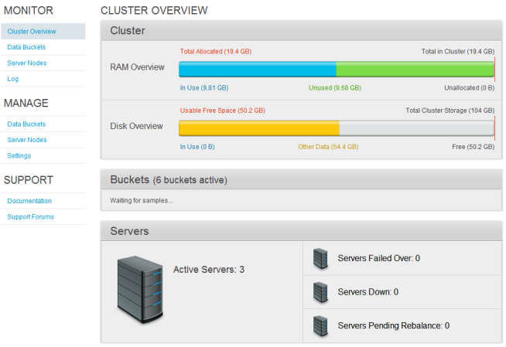
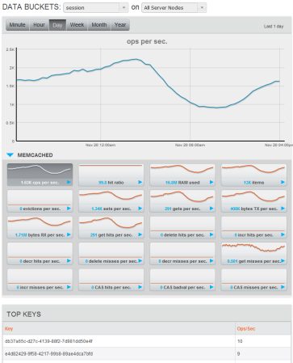
Membase
Super fast (200k+ ops/sec)
Very nice web GUI

Slide 66
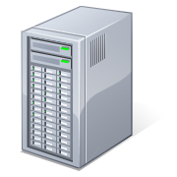
8k ops/sec per server x 6 = 48k ops/sec
8k ops/sec per server x 3 = 24k ops/sec
Membase Cluster
Membase Cluster
Scale Up
Scale Down
Clients
Clients

Slide 67
Membase
Horizontal scaling means…
  Linear increase in throughput
  Linear increase in cost
Semi-automatic scaling up & down
Scaling requires NO downtime

Slide 68
Membase
No queriability
No transactions
Simple Check-And-Set (cas)

Slide 69
Membase
Best used for
  Low-latency data access
  High concurency
  Online gaming (Zynga, iwi, …)

Slide 70
Sql vs Nosql
Friends or Foes?

Slide 71
A.C.I.D
Atomicity
Consistency
Isolation
Durability
Notes:
Atomicity – a transaction is all or nothing.
Consistency – only valid data is written to the database.
Isolation – pretend all transactions are happening serially and the data is correct.
Durability – what you write is what you get.
Problem with ACID is that trying to guarantee atomic transactions across multiple nodes and making sure that all data is consistent and update is HARD. To guarantee ACID under load is down right impossible, which was the premises of Eric Brewer’s CAP theorem as we saw earlier.
However, to minimise downtime, we need multiple nodes to handle node failures, and to make a scalable system we also need many nodes to handle lots and lots of reads and writes.

Slide 72
B.A.S.E
Basically Available
Soft state
Eventually consistent
Notes:
If you can’t have all of the ACID guarantees you can still have two of CAP, which again, stands for:
Consistency – data is correct all the time
Availability – you can read and write your data all the time
Partition Tolerance – if one or more node fails the system still works and becomes consistent when the system comes online
If you drop the consistency guarantee and accept that things will become ‘eventually consistent’ then you can start building highly scalable systems using an architectural approach known as BASE:
Basically Available – system seems to work all the time
Soft State – the state doesn’t have to be consistent all the time
Eventually Consistent – becomes consistent at some later time

Slide 73
Summaries
Before we go...

Slide 74
Considerations
In memory?
Disk-backed persistence?
Managed? Database As A Service?
Cluster support?

Slide 75
SQL or NoSQL?
Wrong question
What’s your problem?
  Transactions
  Amount of data
  Data structure

Slide 76
Key-Value Store
Fast
Good for constant stream of small reads and writes
Good fit for Social gaming

Slide 77
Document Store
Natural data modelling
Programmer friendly
Web friendly
CRUD

Slide 78
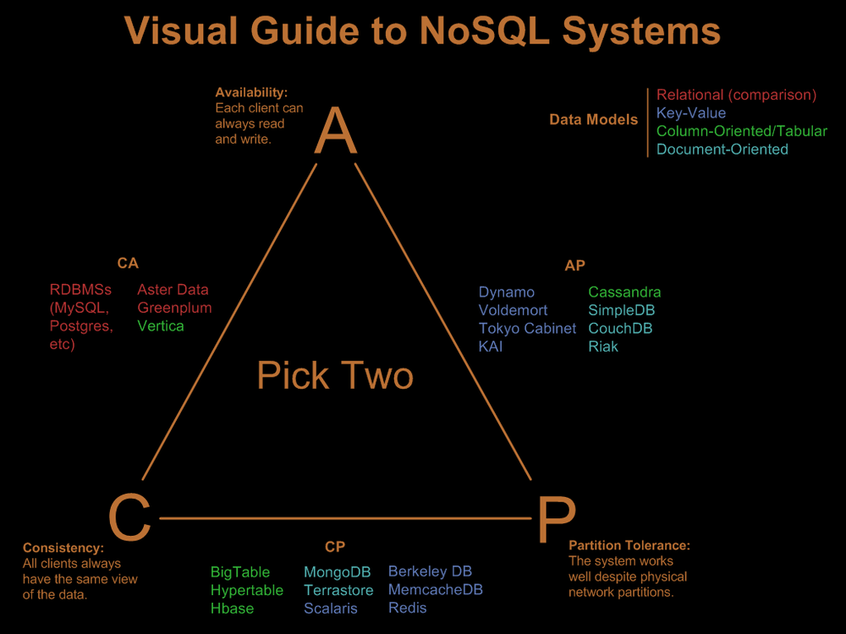
http://blog.nahurst.com/visual-guide-to-nosql-systems

Slide 79
Dynamo DB
Fully managed
Provisioned through-put
Predictable cost & performance
SSD-backed
Auto-replicated

Slide 80
Google BigQuery
Game changer for Analytics industry
Analyze billions of rows in seconds
SQL-like query syntax
Prediction API
NOT a database system
Notes:
And lastly, I’d like to make a honorary mention of a new product from Google that’s likely going to be a complete and utter game changer for the analytics industry.
With BigQuery, you can easily load billions of rows of data from Google Cloud Storage in CSV format and start running ad-hoc analysis over them in seconds.
To make queries against data table in BigQuery, you can use a SQL-like syntax and output the summary data to a Google spreadsheet directly. In fact, you can write your queries in ‘app script’ and trigger them directly from the Google spreadsheet as you would a macro in Excel!
There is also a Predication API which makes analysing your data to give predication a snip!
However, it’s still early days and there are a lot of limitations on table joins. And you need to remember that BigQuery is NOT a database system, it doesn’t support table indexes or other database management features. But it’s a great tool for running analysis on vast amounts of data at a great speed.

Slide 81
Scalability
Success can come unexpectedly and quickly
Not just about the DB

Slide 82

Thank You!
@theburningmonk

